Slide 1
Reinforcement Learning -
Snakes & Ladders Game
Presented By: Hojat Shahriari
Jacob Valenzuela
Libina Bovan Thomas
Nihit Sakhuja
Shreyansh Sisodia

Slide 2
TABLE OF CONTENTS
01
02
03
RESULTS
PROBLEM & OVERVIEW
OUR PROCESS

Slide 3
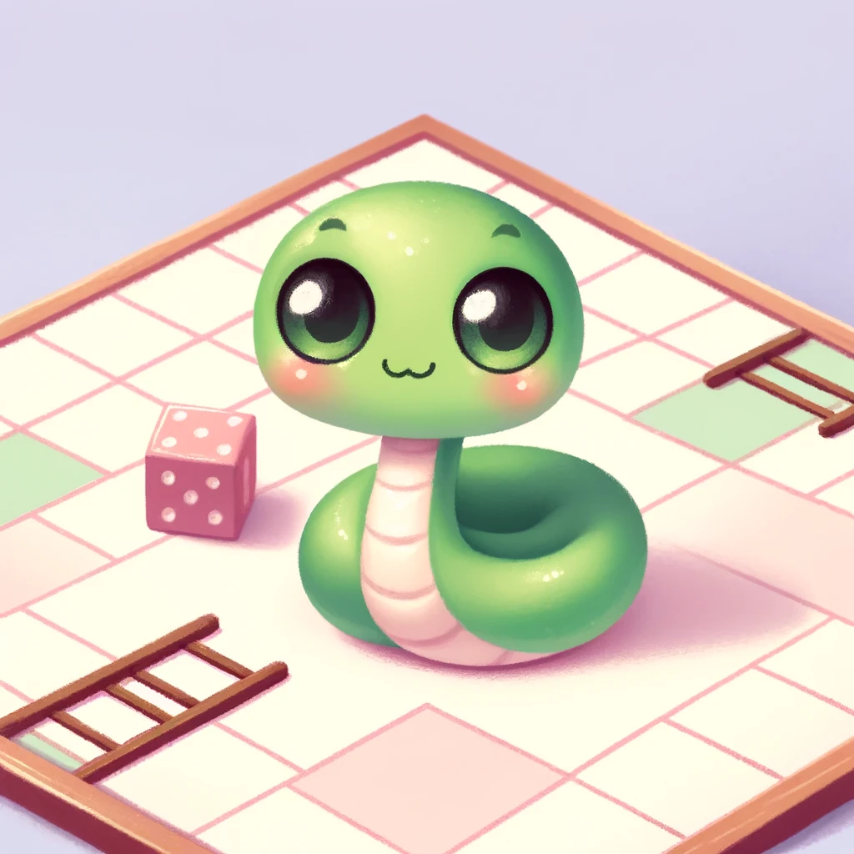
OBJECTIVE
The project aims to apply the Q-learning algorithm within a simulated environment based on the classic game "Snakes and Ladders" to explore reinforcement learning techniques.

Slide 4
Q-LEARNING OVERVIEW
Purpose of Q-Learning
Components of Q-Learning
Q-learning is a model-free reinforcement learning algorithm designed to learn the value of an action in a particular state without requiring a model of the environment.
It aims to enable an agent to learn how to act optimally in any given environment by learning to predict Q-values (expected future rewards) for each state-action pair.
Learning Rate
Discount Factor
Reward System

Slide 5
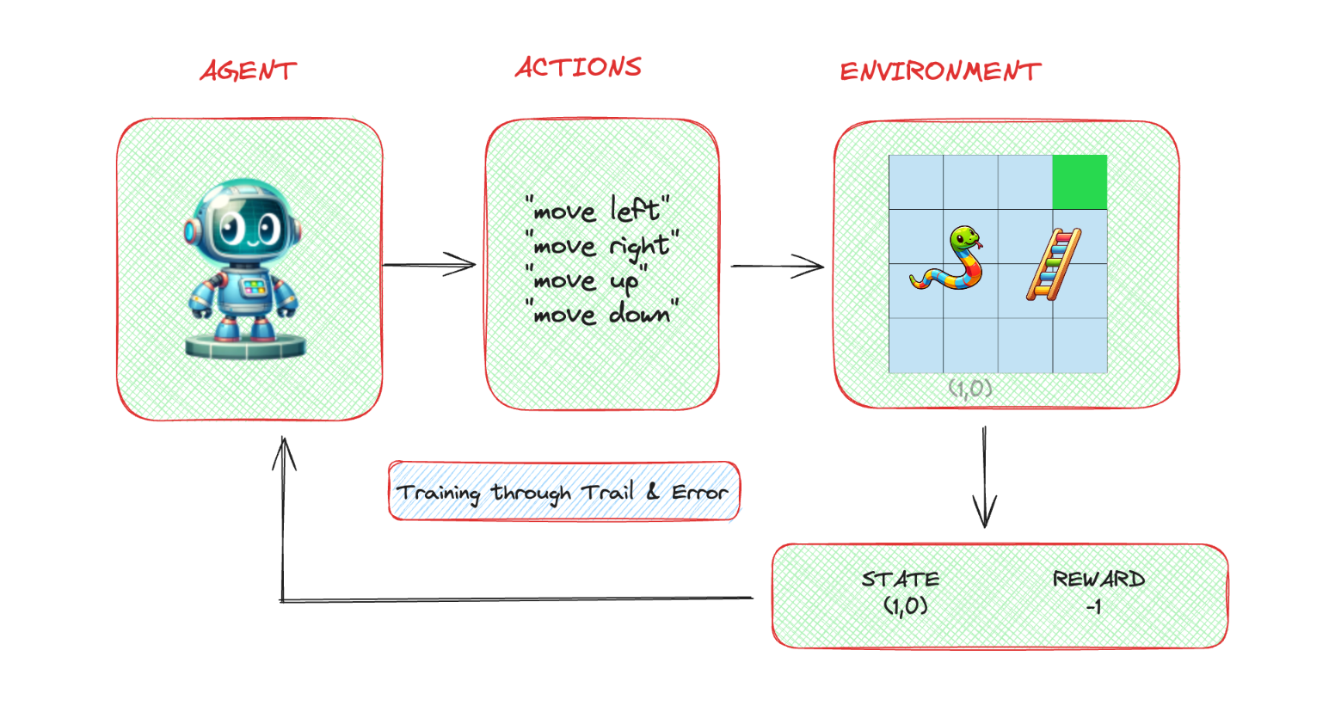
CODE ARCHITECTURE

Slide 6
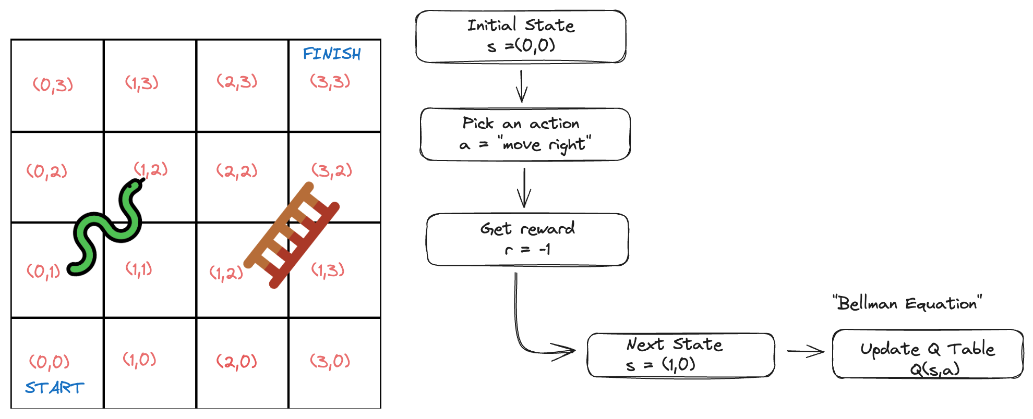
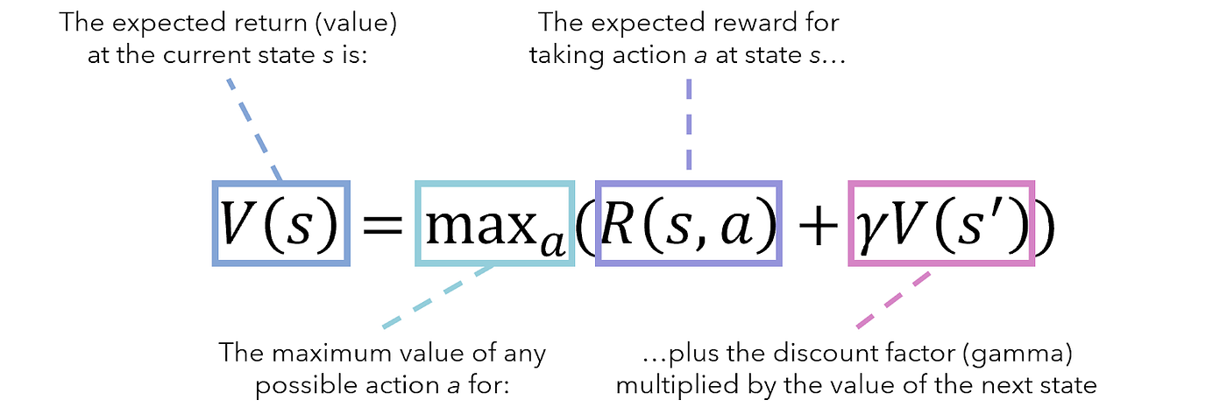
CODE ARCHITECTURE & ALGORITHM
Picture Courtesy: https://andre-ye.medium.com/a-crash-course-in-markov-decision-processes-the-bellman-equation-and-dynamic-programming-e80182207e85

Slide 7
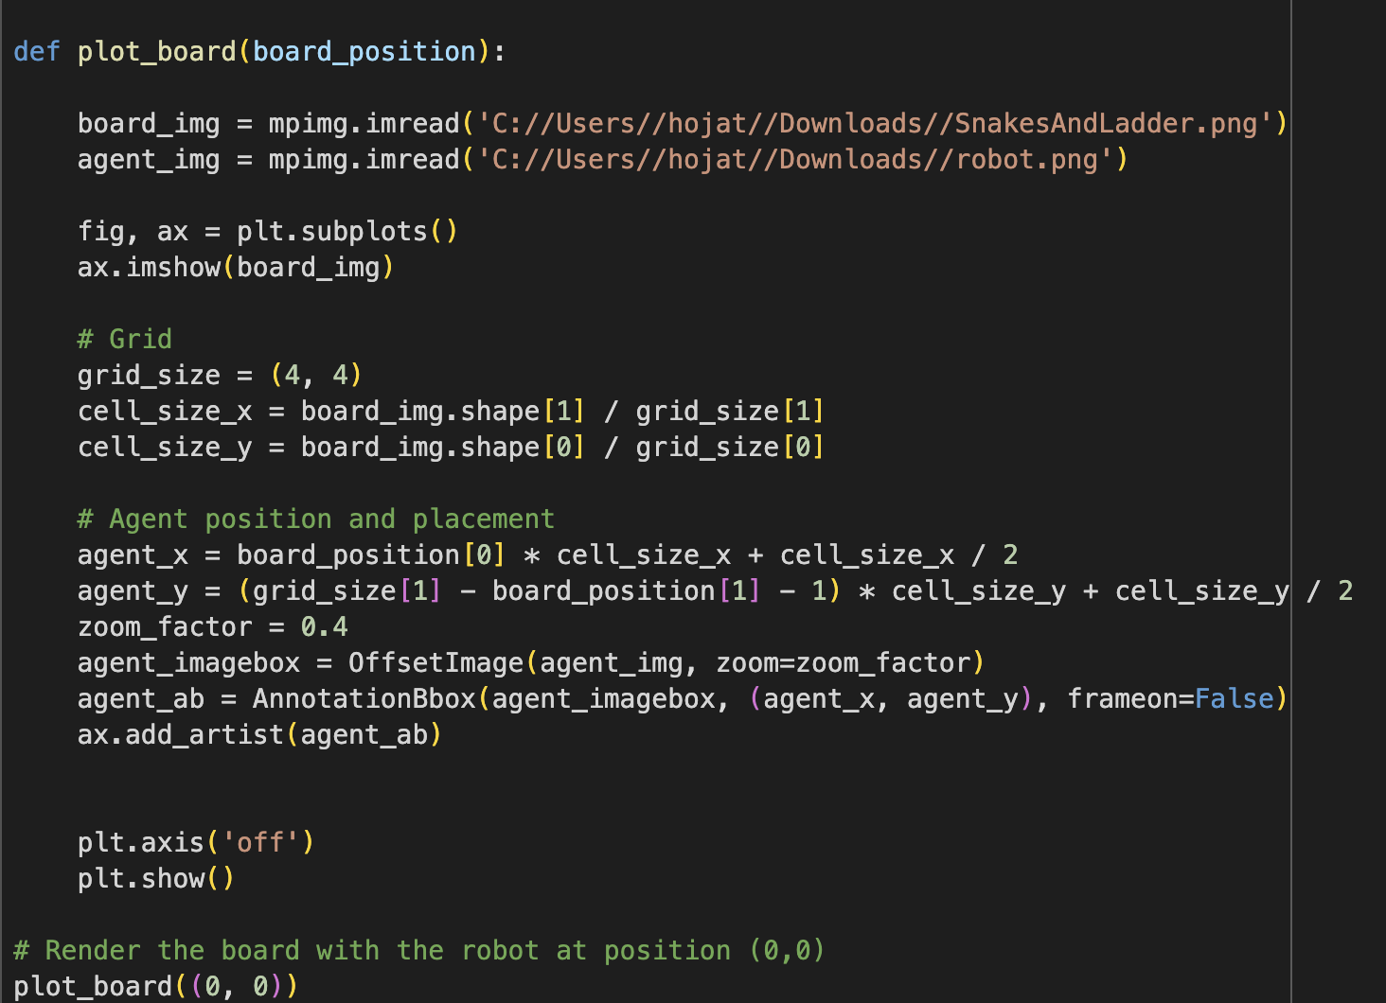
IMPLEMENTATION OF Q-LEARNING
Function that helps build the board

Slide 8
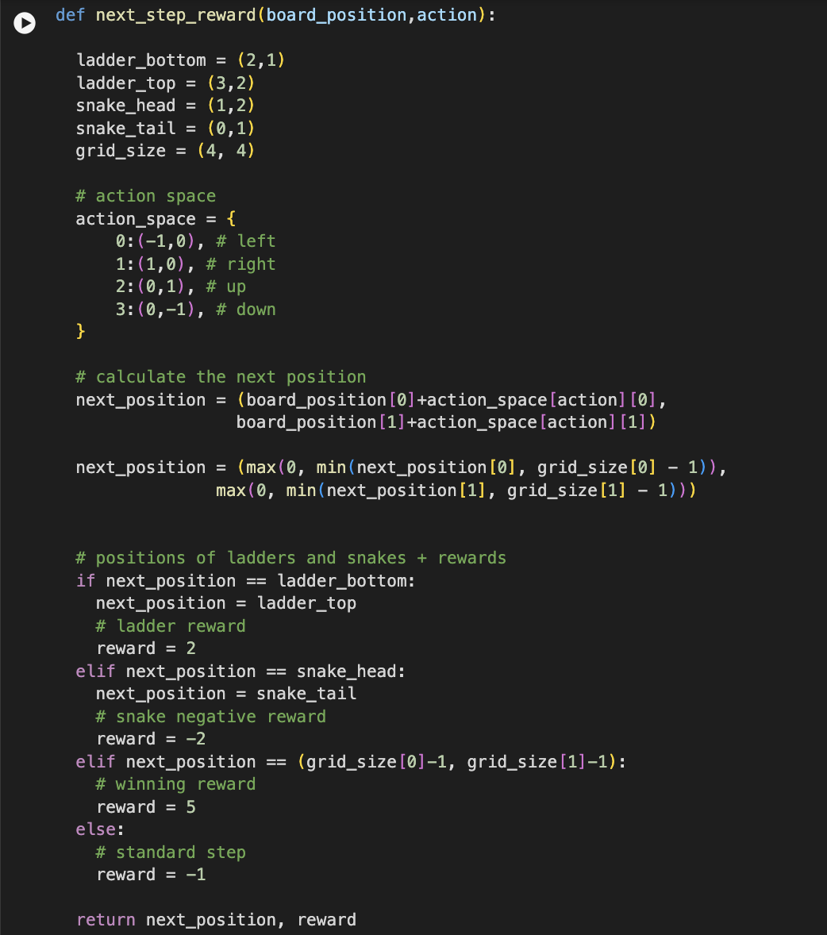
IMPLEMENTATION OF Q-LEARNING
Function that defines the rewards in the game
Reward for reaching the bottom of the ladder is 2
Reward for reaching the Snake head is -2
Reward for taking a step forward in the right direction is -1
Reward for winning is 5

Slide 9
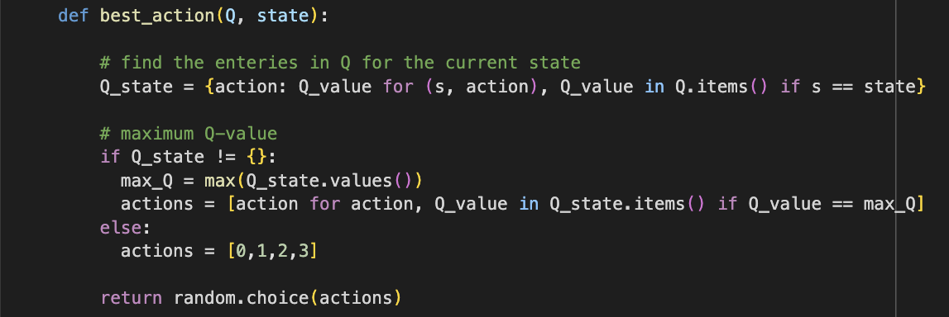
IMPLEMENTATION OF Q-LEARNING
Function that helps in choosing the best action

Slide 10
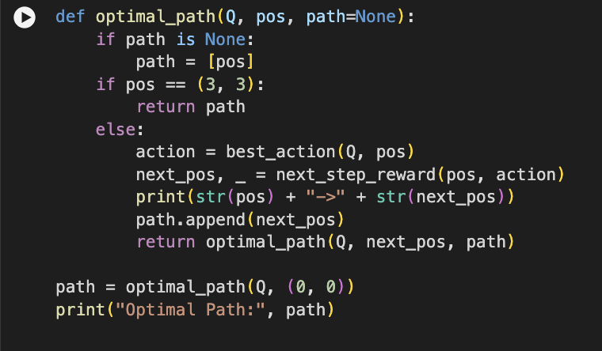
IMPLEMENTATION OF Q-LEARNING
Function showing the optimal path

Slide 11
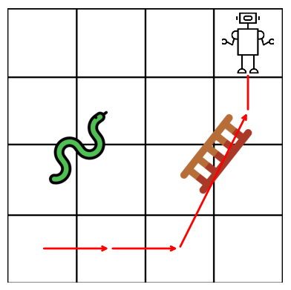
RESULTS OBTAINED
On implementation of this code, we will be able to determine the optimal path that the agent(here, the robot) can take to reach the finish point.

Slide 12
CODE DEMO

Slide 13
REFERENCES
https://cameronrwolfe.substack.com/p/basics-of-reinforcement-learning
https://towardsdatascience.com/q-learning-algorithm-from-explanation-to-implementation-cdbeda2ea187
https://medium.com/@Kaushik_Dayalan/bellman-equation-value-functions-reinforcement-learning-b8a0a1cad84f

Slide 14
THANKS

